Slide 1
First output model for Typhoon (compared with Boulder model)
15.October 2022.

Slide 2
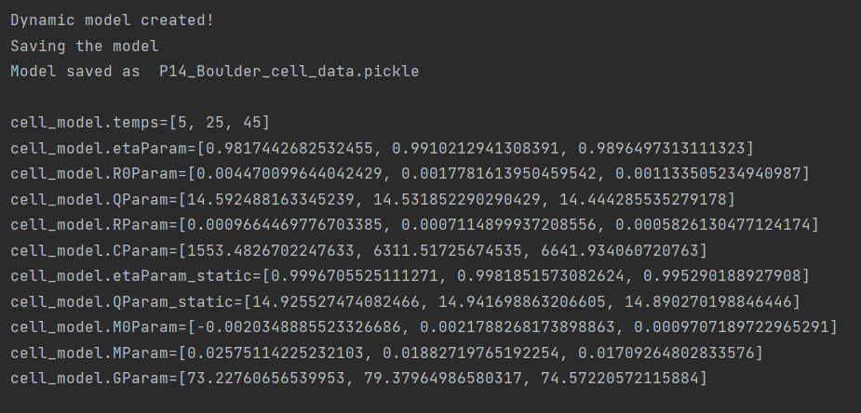
Boulder

Slide 3
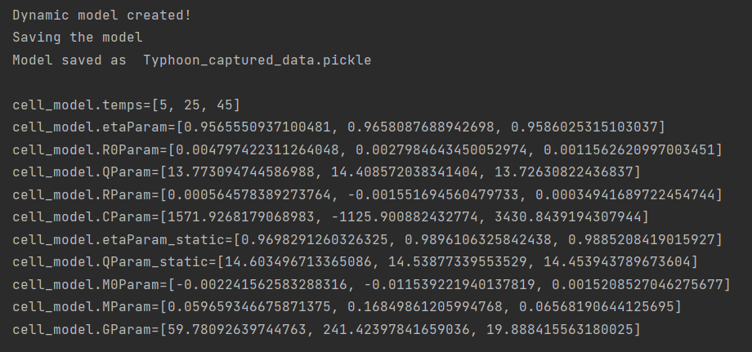
Some problems with Eigenvalues which translate into negative R param and C param

Slide 4
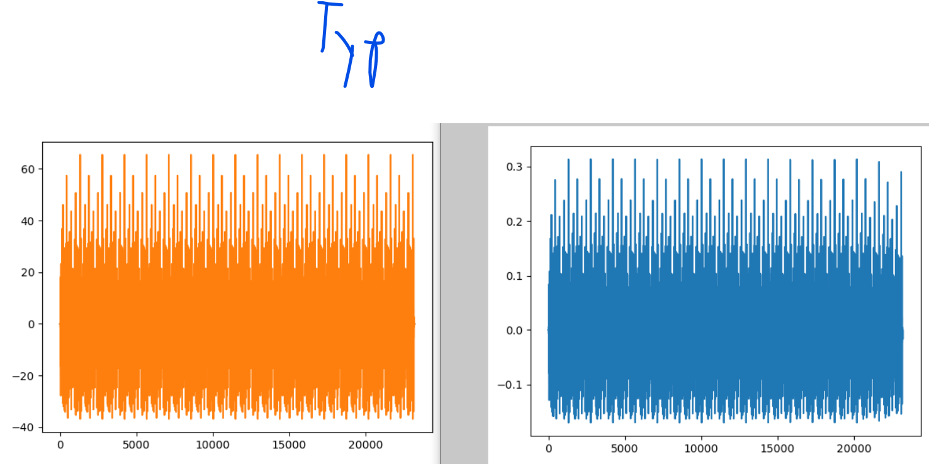
Problems probably come from v_error and corrected current calculation

Slide 5
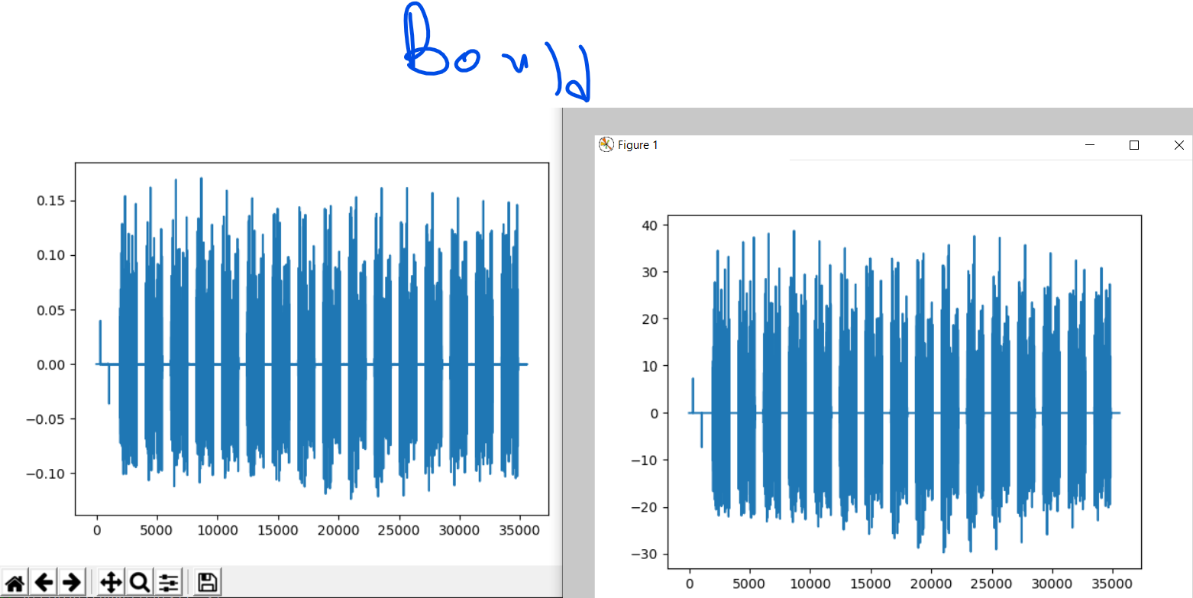

Slide 6
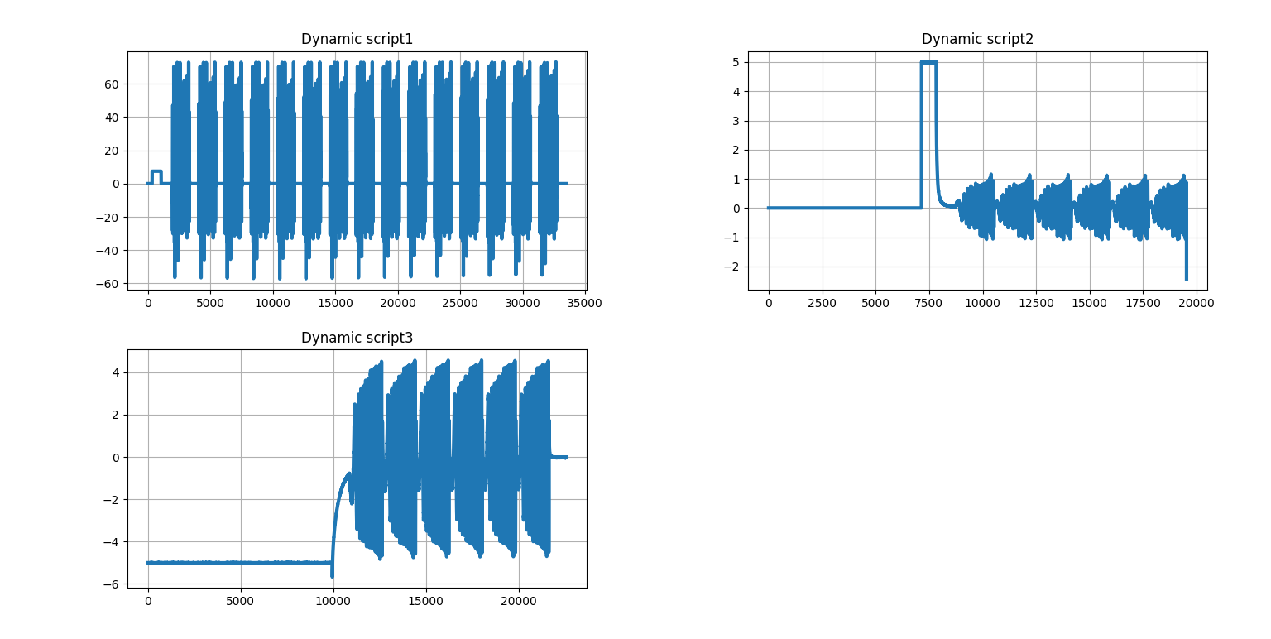
dynamic_scripts_current

Slide 7
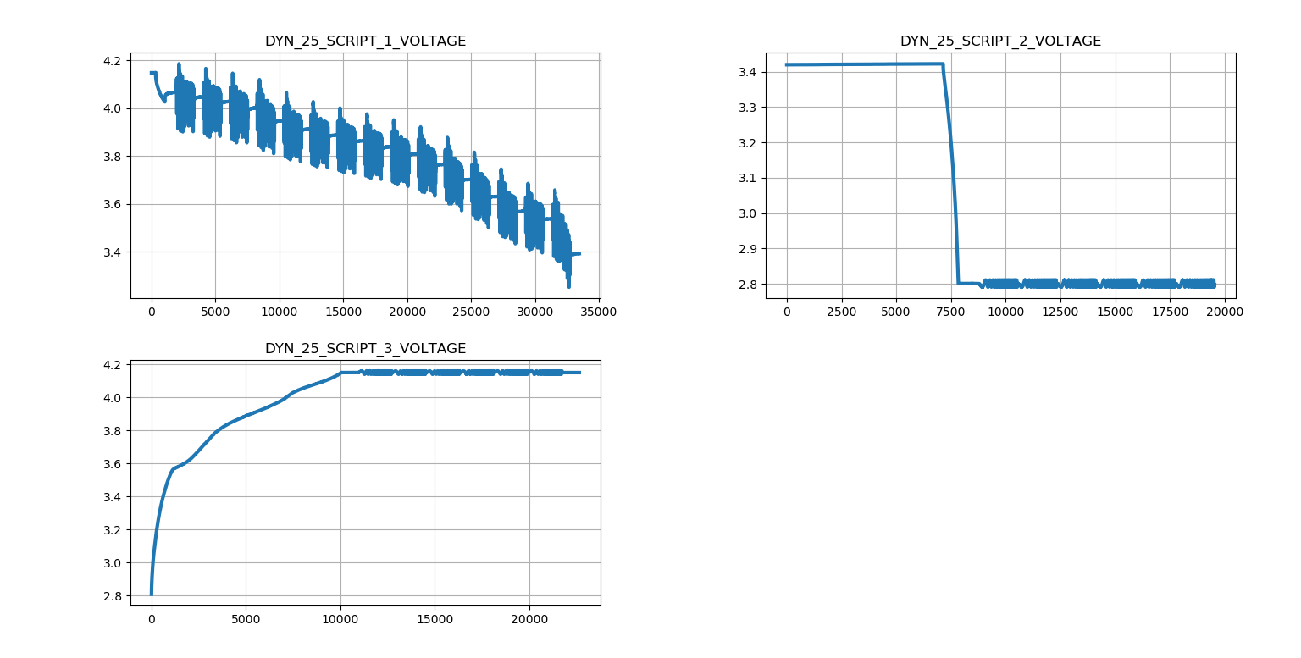
dynamic_scripts_voltage

Slide 8
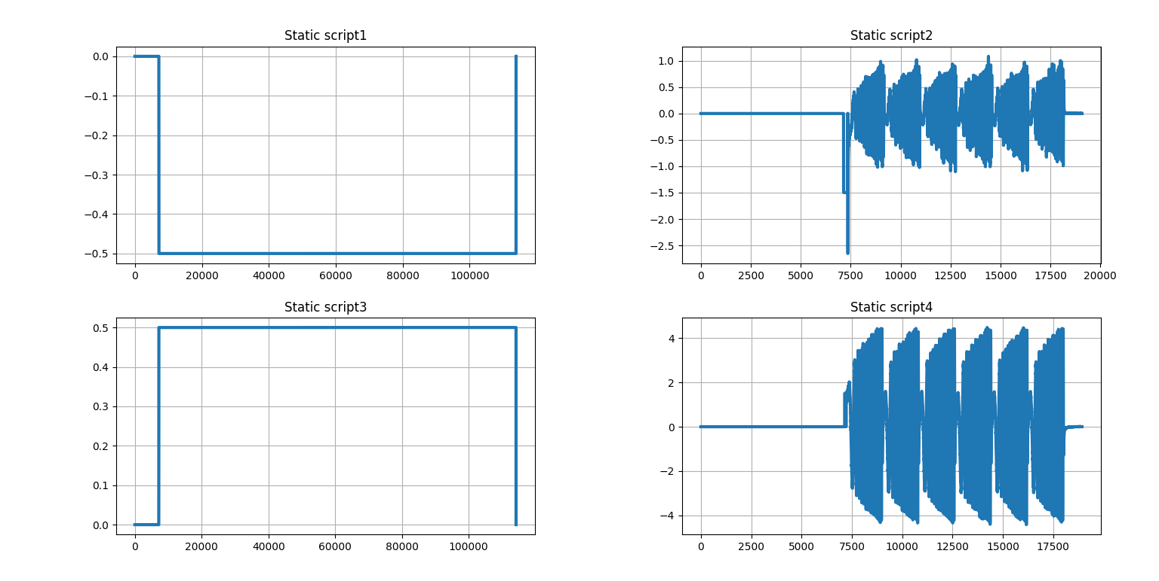
static_scripts_current

